Slide 1
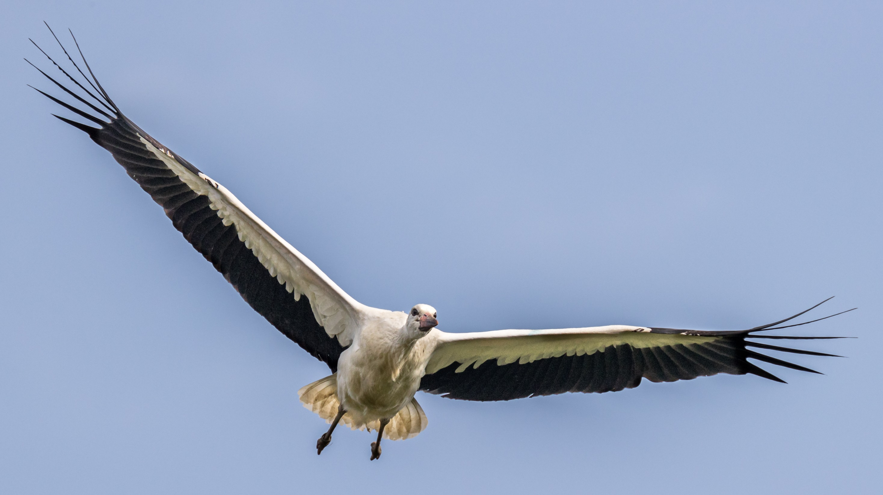
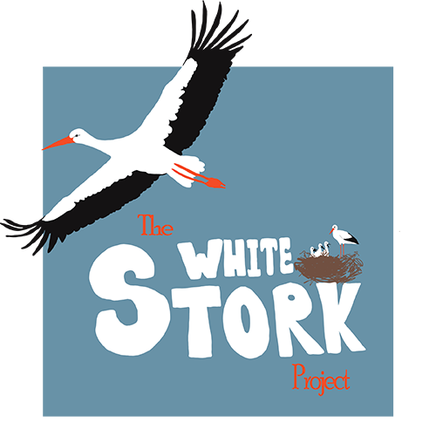
White Storks Taking Flight: Lesson 2
Reconnecting with a wilder Britain

Slide 2
Starter: How many of these key terms from last lesson can you write definitions for?
Adaptation | Special features that an organism has, to help it survive in its environment.
Habitat | The place where an organism lives
Pollution | The introduction to harmful materials into an environment.
Migration | The seasonal movement of animals from one area to another
Incubation | The process birds and some other animals use to maintain the right heat and humidity to hatch an egg
Ecosystem | A biological community of organisms interacting with their environment
Population | The number of individuals of a particular species living in an area.
Predator | An animal that hunts and eats other animals.
Prey | An animal that is hunted. Some animals are both predator and prey.

Slide 3
Answers
Adaptation | Special features that an organism has, to help it survive in its environment.
Habitat | The place where an organism lives
Pollution | The introduction to harmful materials into an environment.
Migration | The seasonal movement of animals from one area to another
Incubation | The process birds and some other animals use to maintain the right heat and humidity to hatch an egg
Ecosystem | A biological community of organisms interacting with their environment
Population | The number of individuals of a particular species living in an area.
Predator | An animal that hunts and eats other animals.
Prey | An animal that is hunted. Some animals are both predator and prey.

Slide 4
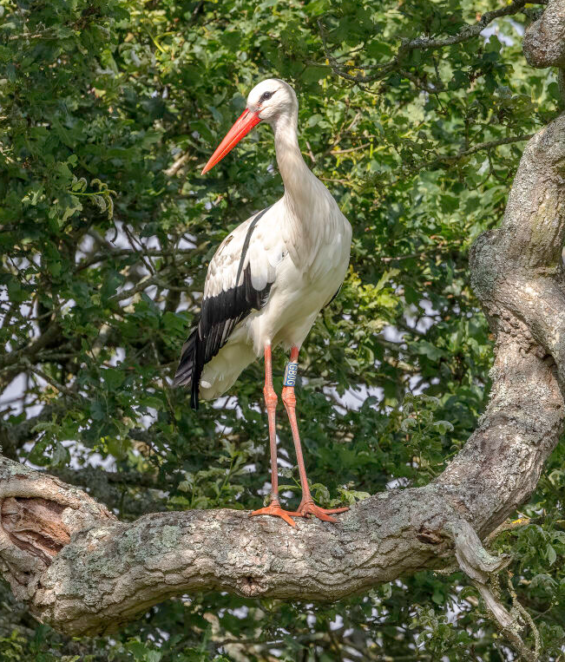
Activity: Adaptations
Look at the photograph and discuss:
What is meant by the term adaptation?
Suggest any adaptations you think a stork has.
Explain how these help the stork to survive.

Slide 5
Large, sharp beak
The sharp beak can be up to 30 cm long and is adapted for collecting small insects as well as larger prey. It can also be used to defend the animal. The beak can also be used to make intricate nests and make sounds to communicate with each other.
Fantastic eyesight
Storks have brilliant vision. They have to be able to see tiny insects that make up their food, but also be able to navigate from up to 5km above the surface of the Earth.
Good sense of smell
Birds can have a surprisingly good sense of smell. There are records of storks being able to detect the smell of cut grass (where they get a lot of insects from), from over 20km away!
Long legs
Storks often forage for food in wetland and grassy areas. Having long legs allows them to move easily through undergrowth and see above plants to locate prey.
Wide feet
The large feet and strong claws of a stork help it to land in trees. They also have a large surface area so the stork can move on wet ground easily without sinking.
Powerful, large wings
The wingspan of a stork can be up to 2m. They are fantastic at using these wings to glide on air thermals to help them conserve energy, allowing them to make journeys of thousands of kilometres.

Slide 6
Stork adaptations activity
Can you write a paragraph/ draw and label a diagram/ write a list of bullet points explaining how storks are adapted to survive in their environment.
Extension:
Compare the adaptations of the stork to any other birds that you know about and explain why they are different.
For example – why would a Barn Owl have a different shaped beak to a White Stork?

Slide 7
Stork reproduction:

Slide 8
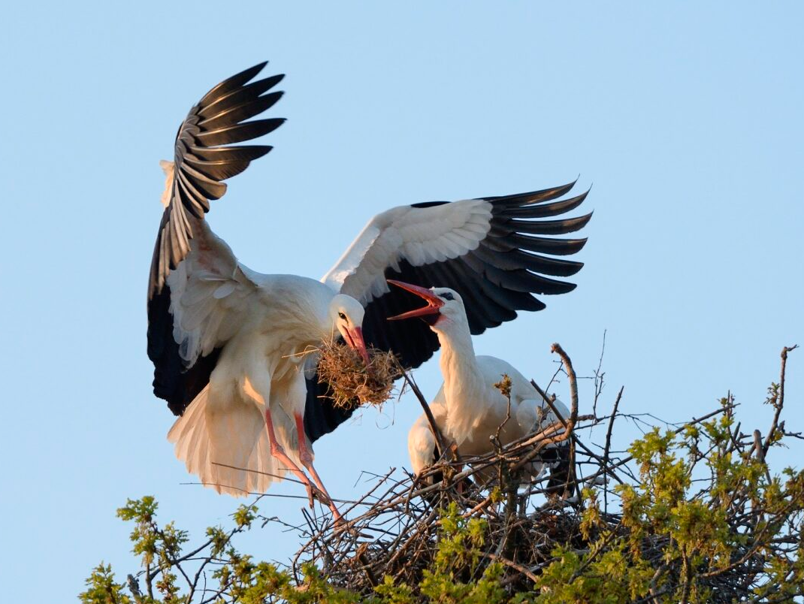
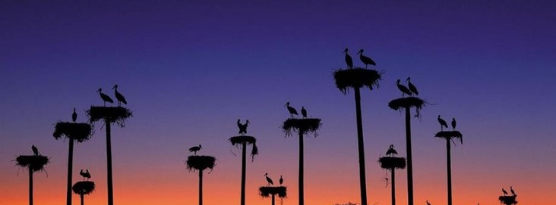
In spring each year, adult storks return to the colony they hatched in and start to build or rebuild nests.
Storks often (but not always) partner for life.
Storks can live for 30 years and return to the same nest for decades.

Slide 9
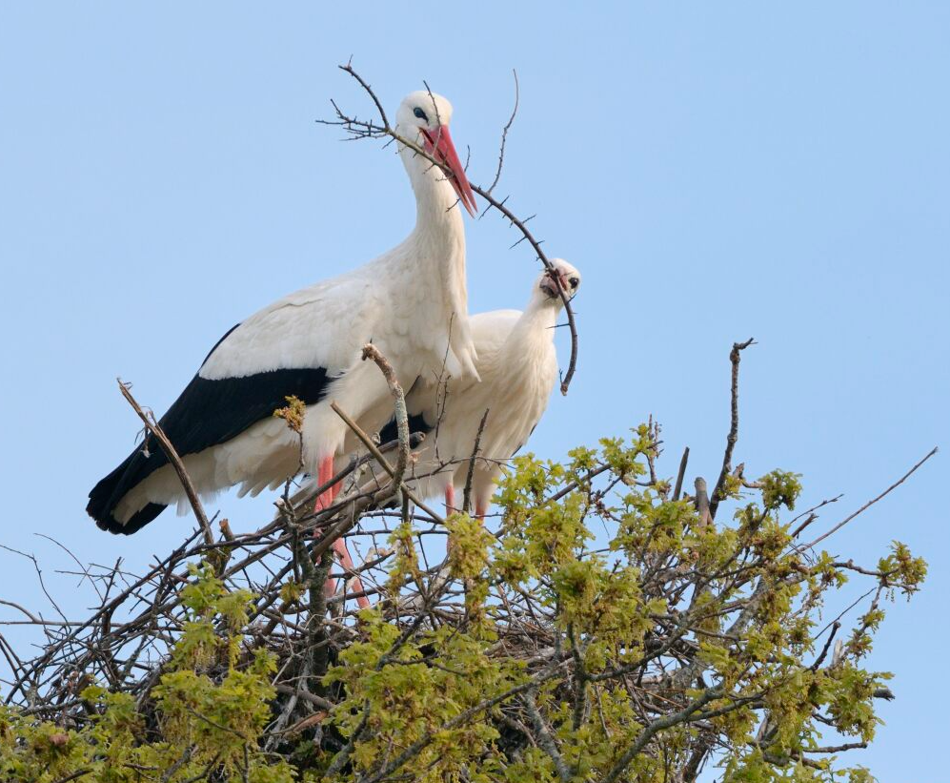
A stork nest is typically around 2 meters wide and at least a meter deep, weighing half a tonne.
However, they can range in size a lot as they are built on every year, and some can be much larger than this.
There is a town in Germany where the rumour is, a single stork nest has been used by different stork pairs for over 300 years!

Slide 10
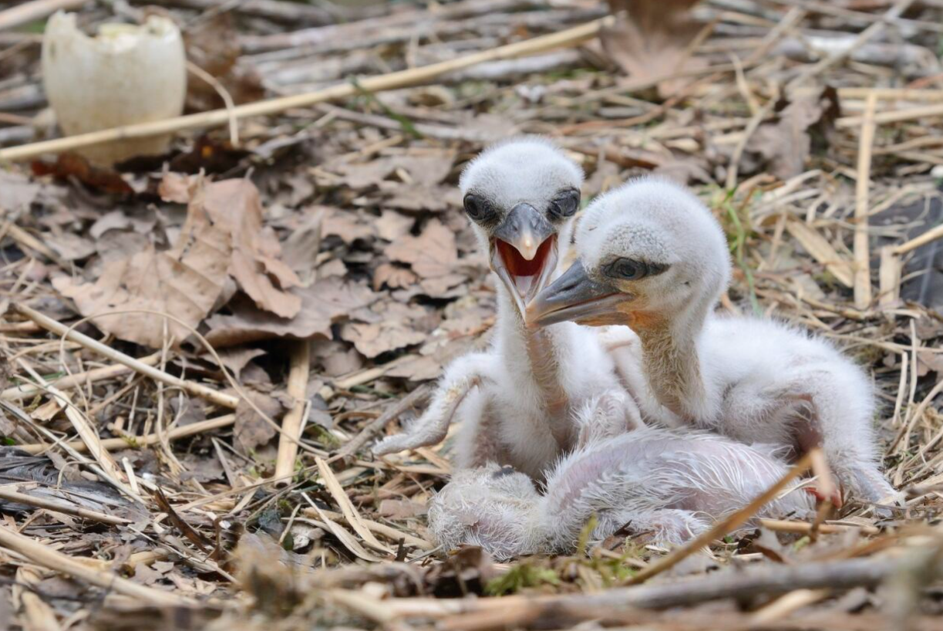
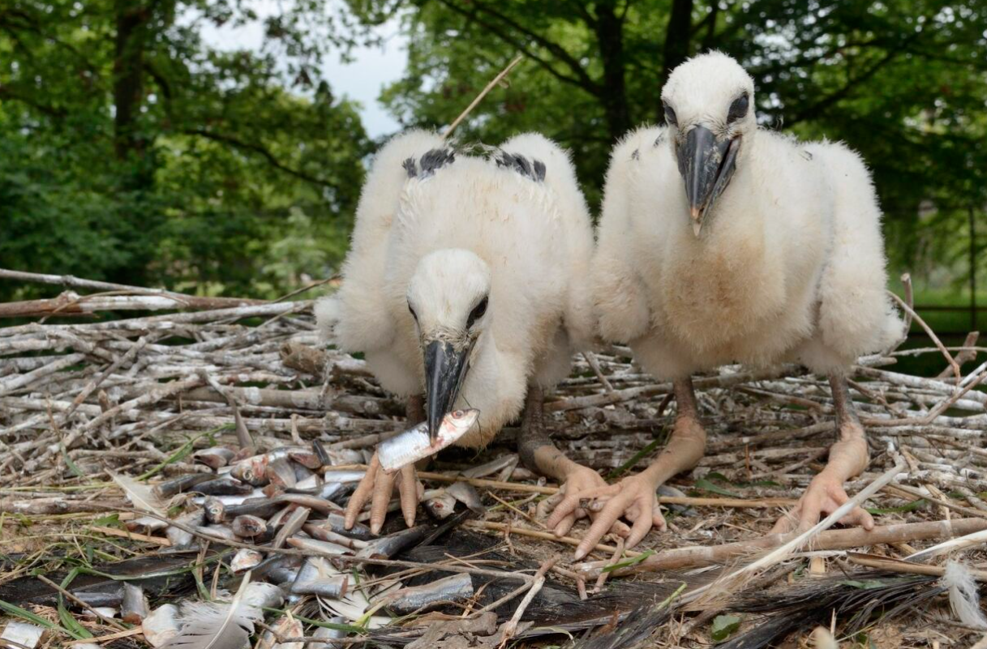
4 days old
A maximum of 5 eggs will be laid in a nest.
They take 32-34 days to hatch, and both parents take it in turns to incubate them.
The young chicks grow very fast, and the parents work hard to collect enough food before regurgitating it into the centre of the nest for the young to then feed.
16 days old

Slide 11
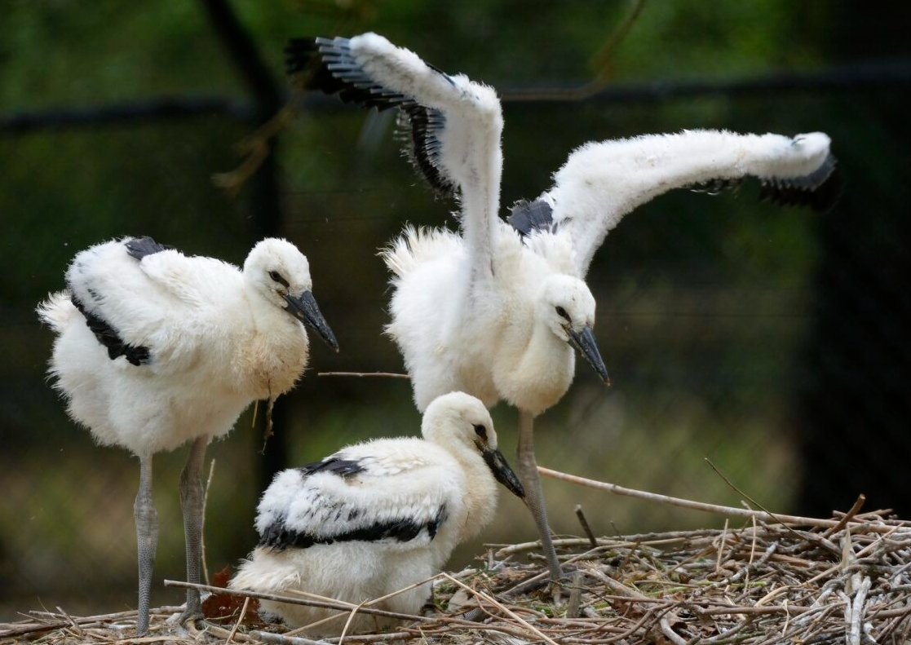
The young will start to flap their wings to help build muscles from around 5 weeks old.
Then, after around 60 to 70 days, they will fledge the nest and start flying.
Usually, they do keep returning to the same nest to get food from the parents for a few weeks after fledging.

Slide 12
Stork reproduction: Activity
Can you write a paragraph or complete a story board, summarising the journey of stork reproduction?
Key facts to include:
- How the nest is built and how big it is
- How eggs are incubated and how long they take to hatch
- A description of how the parents look after the growing chicks
- Statement of how long chicks take to grow before they fledge
- Description of what the chicks eat
- Explanation of how chicks learn to fly
- Description of how storks like to build nests next to each other

