Slide 1
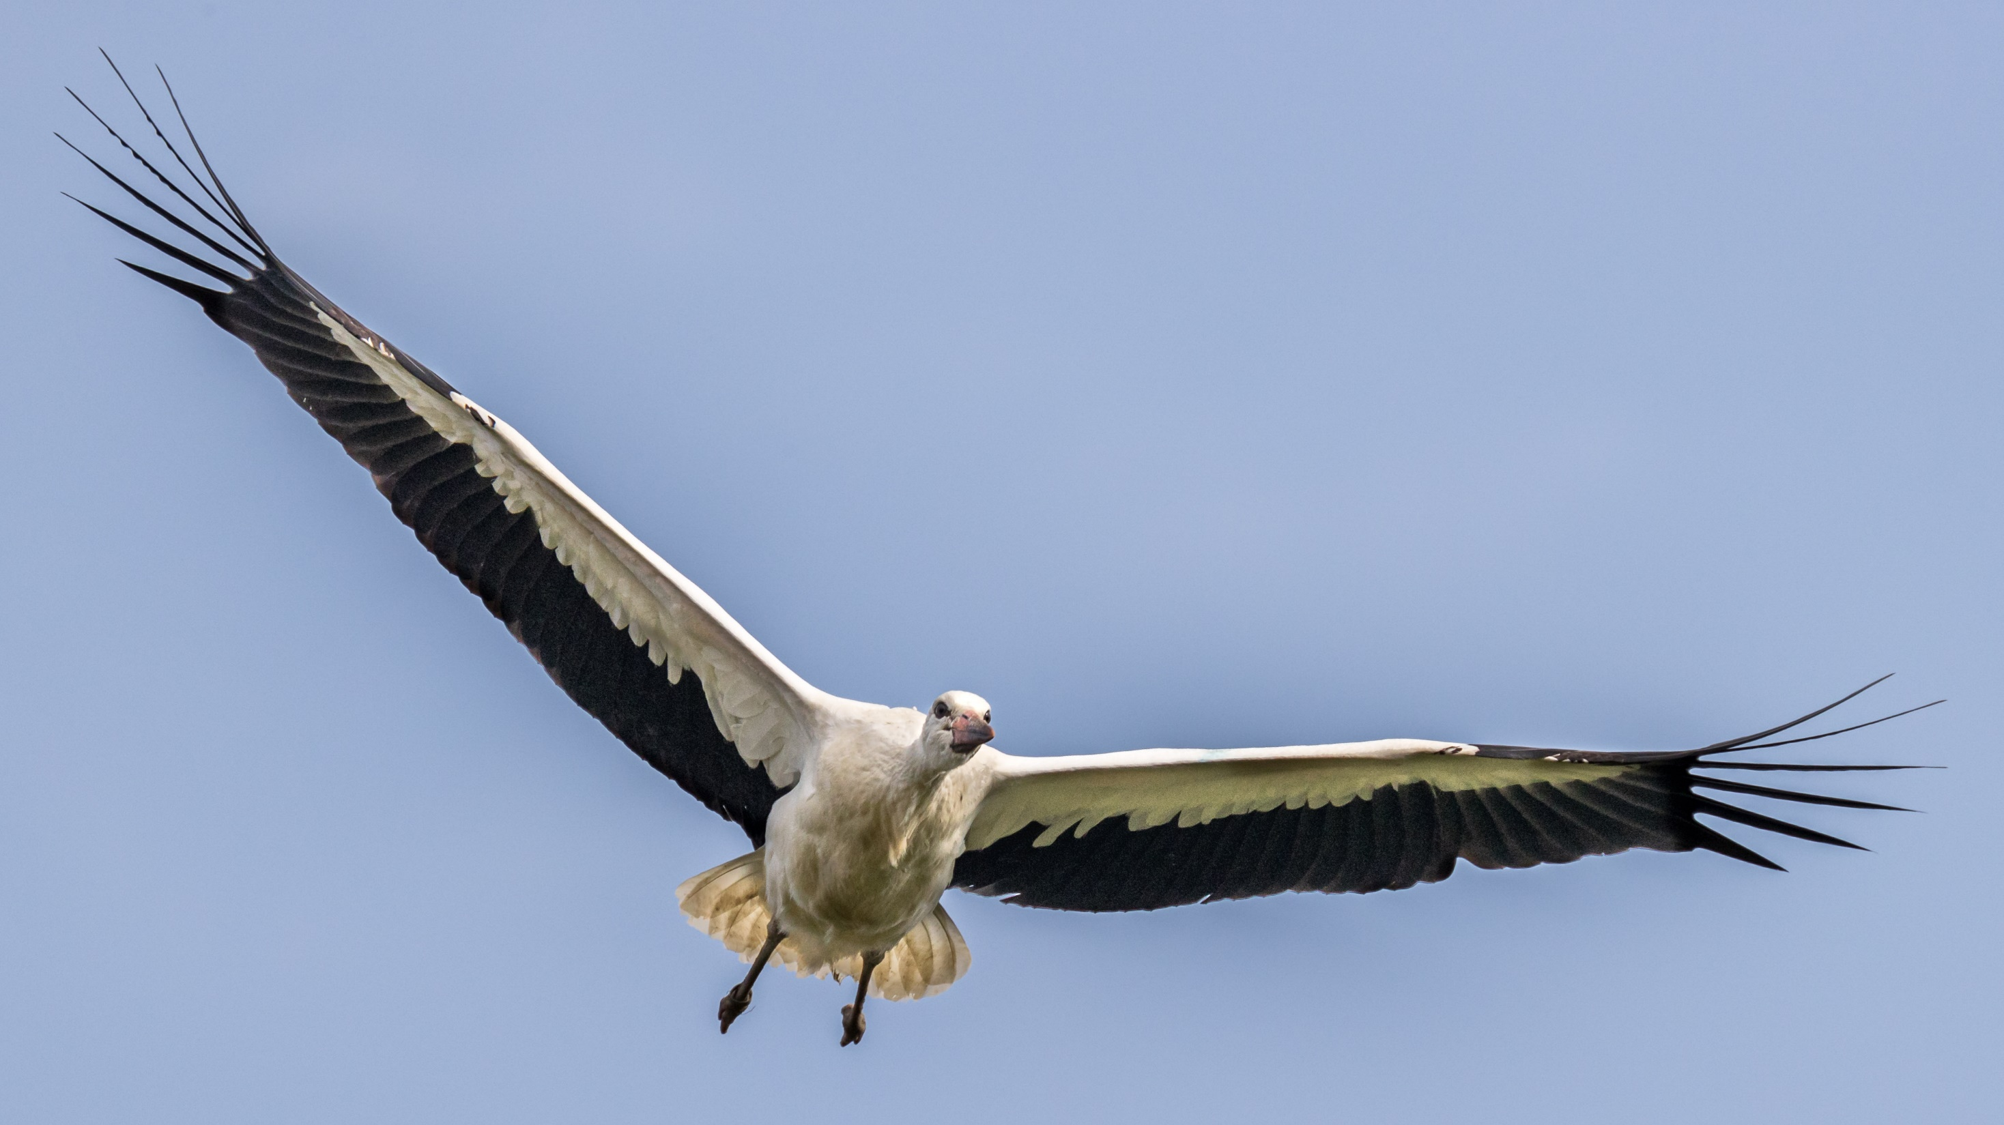
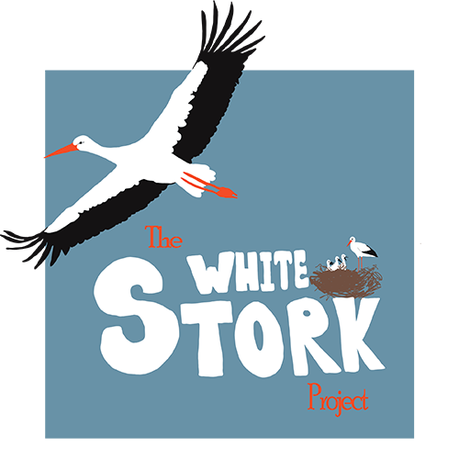
White Storks Taking Flight: Lesson 1
Reconnecting with a wilder Britain

Slide 2
Key terms
Adaptation | Special features that an organism has, to help it survive in its environment.
Habitat | The place where an organism lives
Pollution | The introduction to harmful materials into an environment.
Migration | The seasonal movement of animals from one area to another
Incubation | The process birds and some other animals use to maintain the right heat and humidity to hatch an egg
Ecosystem | A biological community of organisms interacting with their environment
Population | The number of individuals of a particular species living in an area.
Predator | An animal that hunts and eats other animals.
Prey | An animal that is hunted. Some animals are both predator and prey.

Slide 3
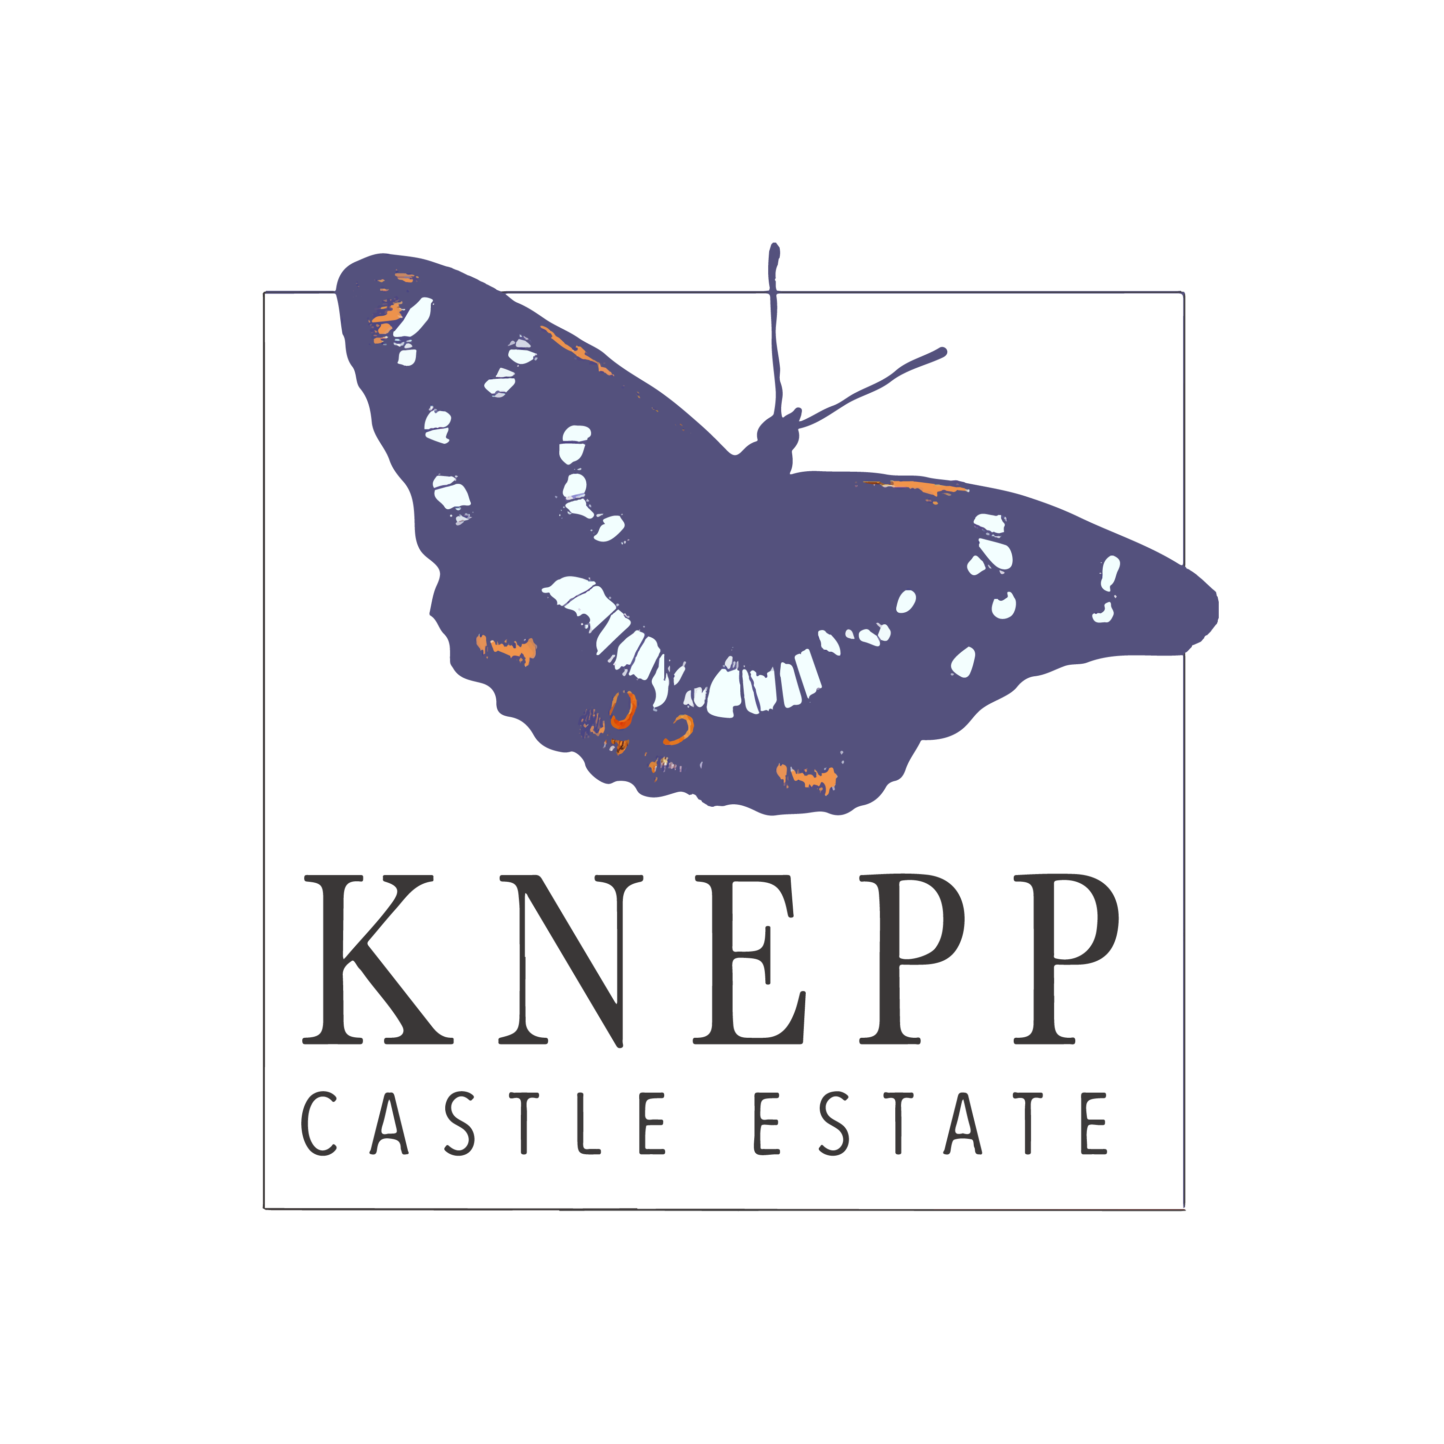
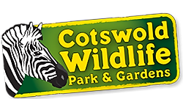
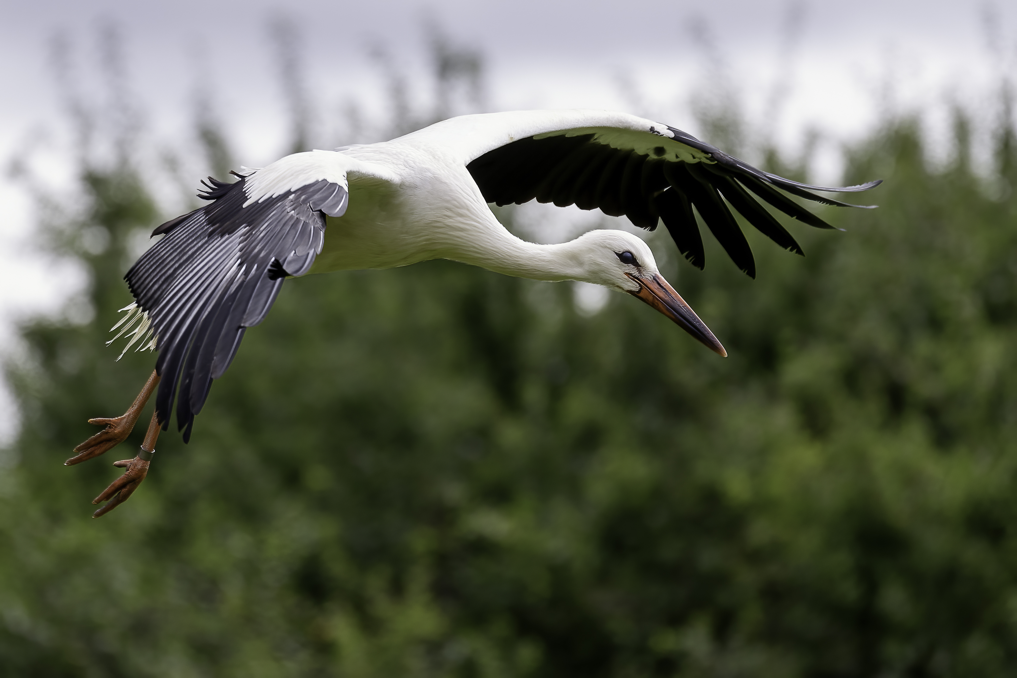
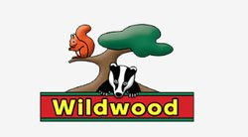
About the White Stork Project
The White Stork Project started in 2016 and is made up of a partnership of private landowners and nature conservation organisations.
Storks used to be breeding the in the UK but because of human actions were wiped out. They have a particular history with the South of the UK and a key part of the project is based at the Knepp Estate in Horsham.
The aim is to establish a self-sustaining population of White Storks in Southern England by 2030
© Kevin Harwood

Slide 4
What do you know about white storks?
Have you ever seen them in different countries? Where?
Notes:
- Students are likely to have seen storks and possibly stork nests across different places in Europe including France, Portugal, Poland, Germany, Spain and Belgium. They have distinctive large nests which can be found on houses, churches and other structures as well as mature trees. However, they were not always common in these areas.
- Storks declined in number across Europe (habitat destruction and hunting) and the success they have now is due to reintroduction programmes (Switzerland in 1948, Alsace in 1972, Belgium in 1987 and Sweden in 1989). In the UK, we are following the methodology of some of these successful projects.

Slide 5
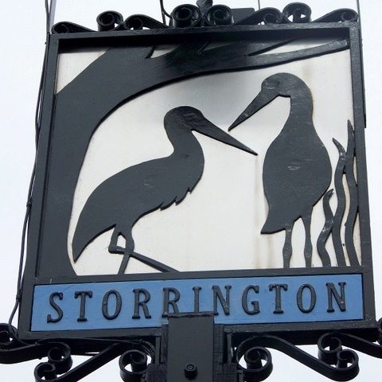
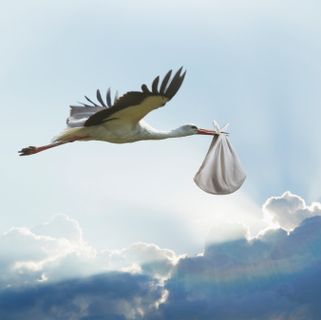
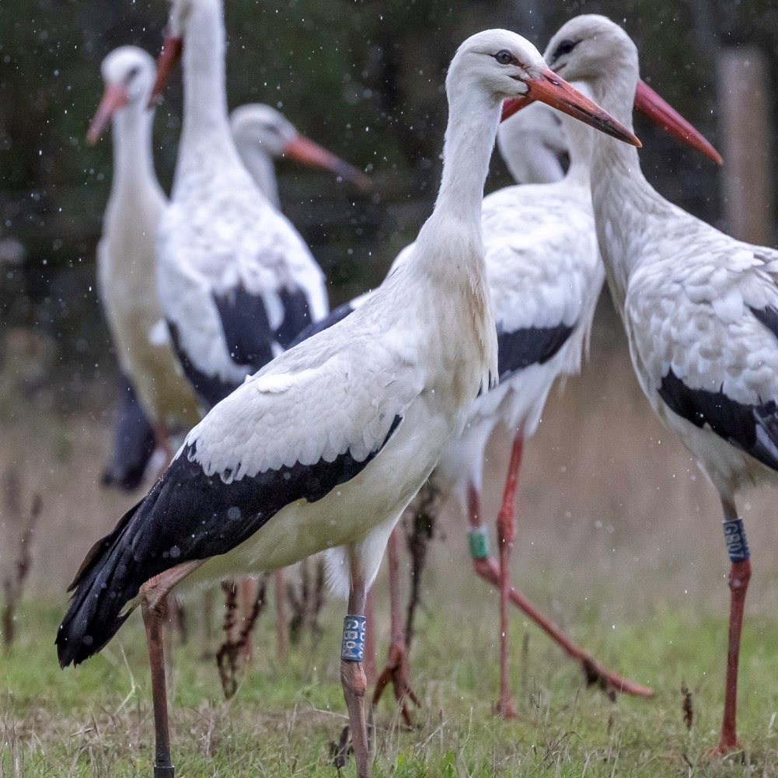
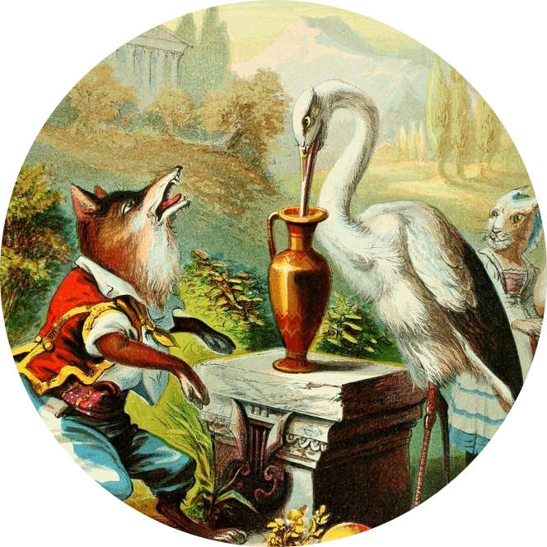
Across Europe, white storks have lived alongside people for generations, becoming part of the culture and heritage of those countries.
There is archaeological evidence to suggest storks were present here, last breeding 600 years ago.
They are also part of UK culture, with the familiar tale of storks bringing babies mentioned in literature and stories for hundreds of years
Evidence in place names of today such as our nearby village of Storrington which means ‘the village of the storks’ in old English.
Notes:
- In 1185, Storrington was called ‘Storketon’ which in Old English means ‘Homestead with the storks’. The village sign still displays a pair of storks.
- There were over 1115 sightings of white storks over the UK recorded between 1958 and 2013

Slide 6
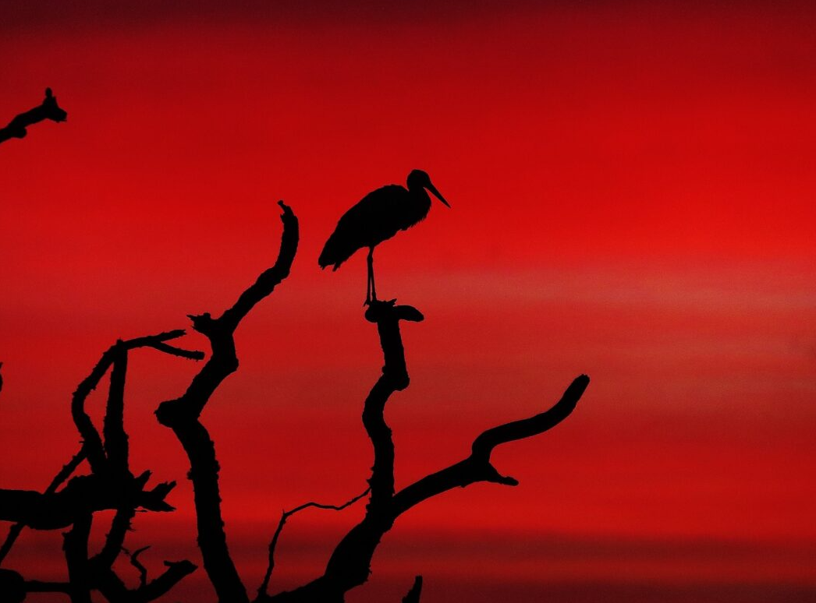
Every year, for the last few decades between 20 to 30 storks fly across the channel to the South of England looking for places to land. What happened – why do they not live here anymore?

Slide 7
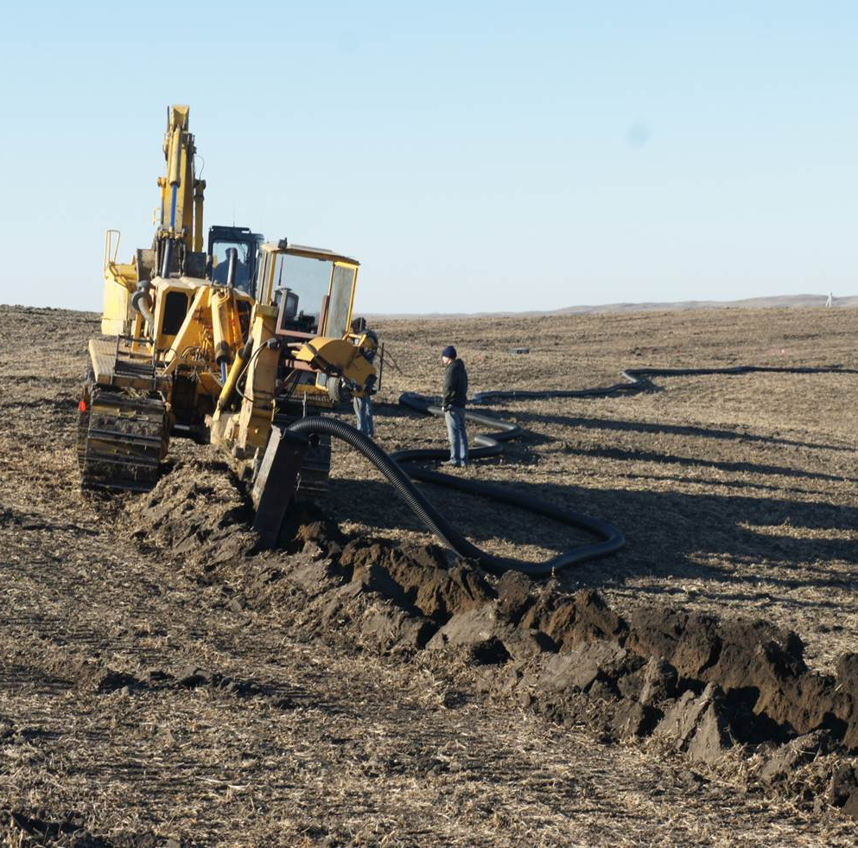
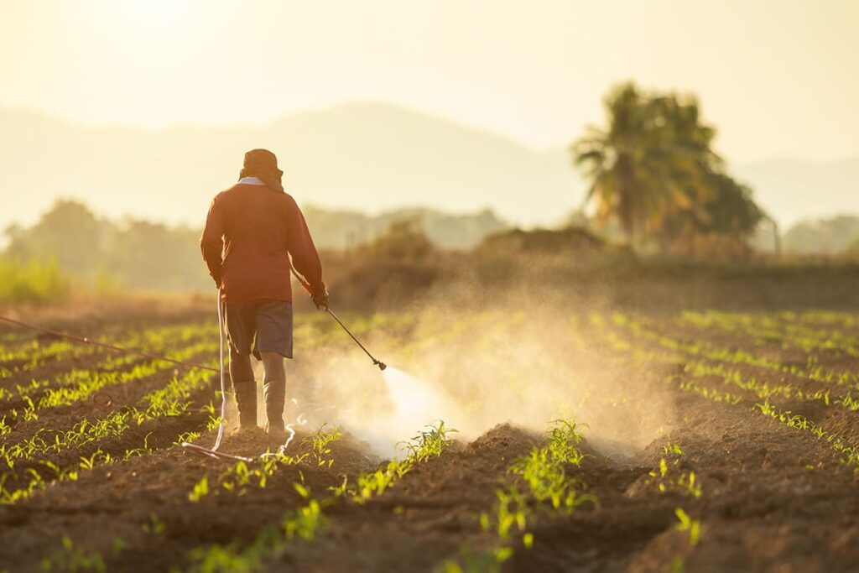
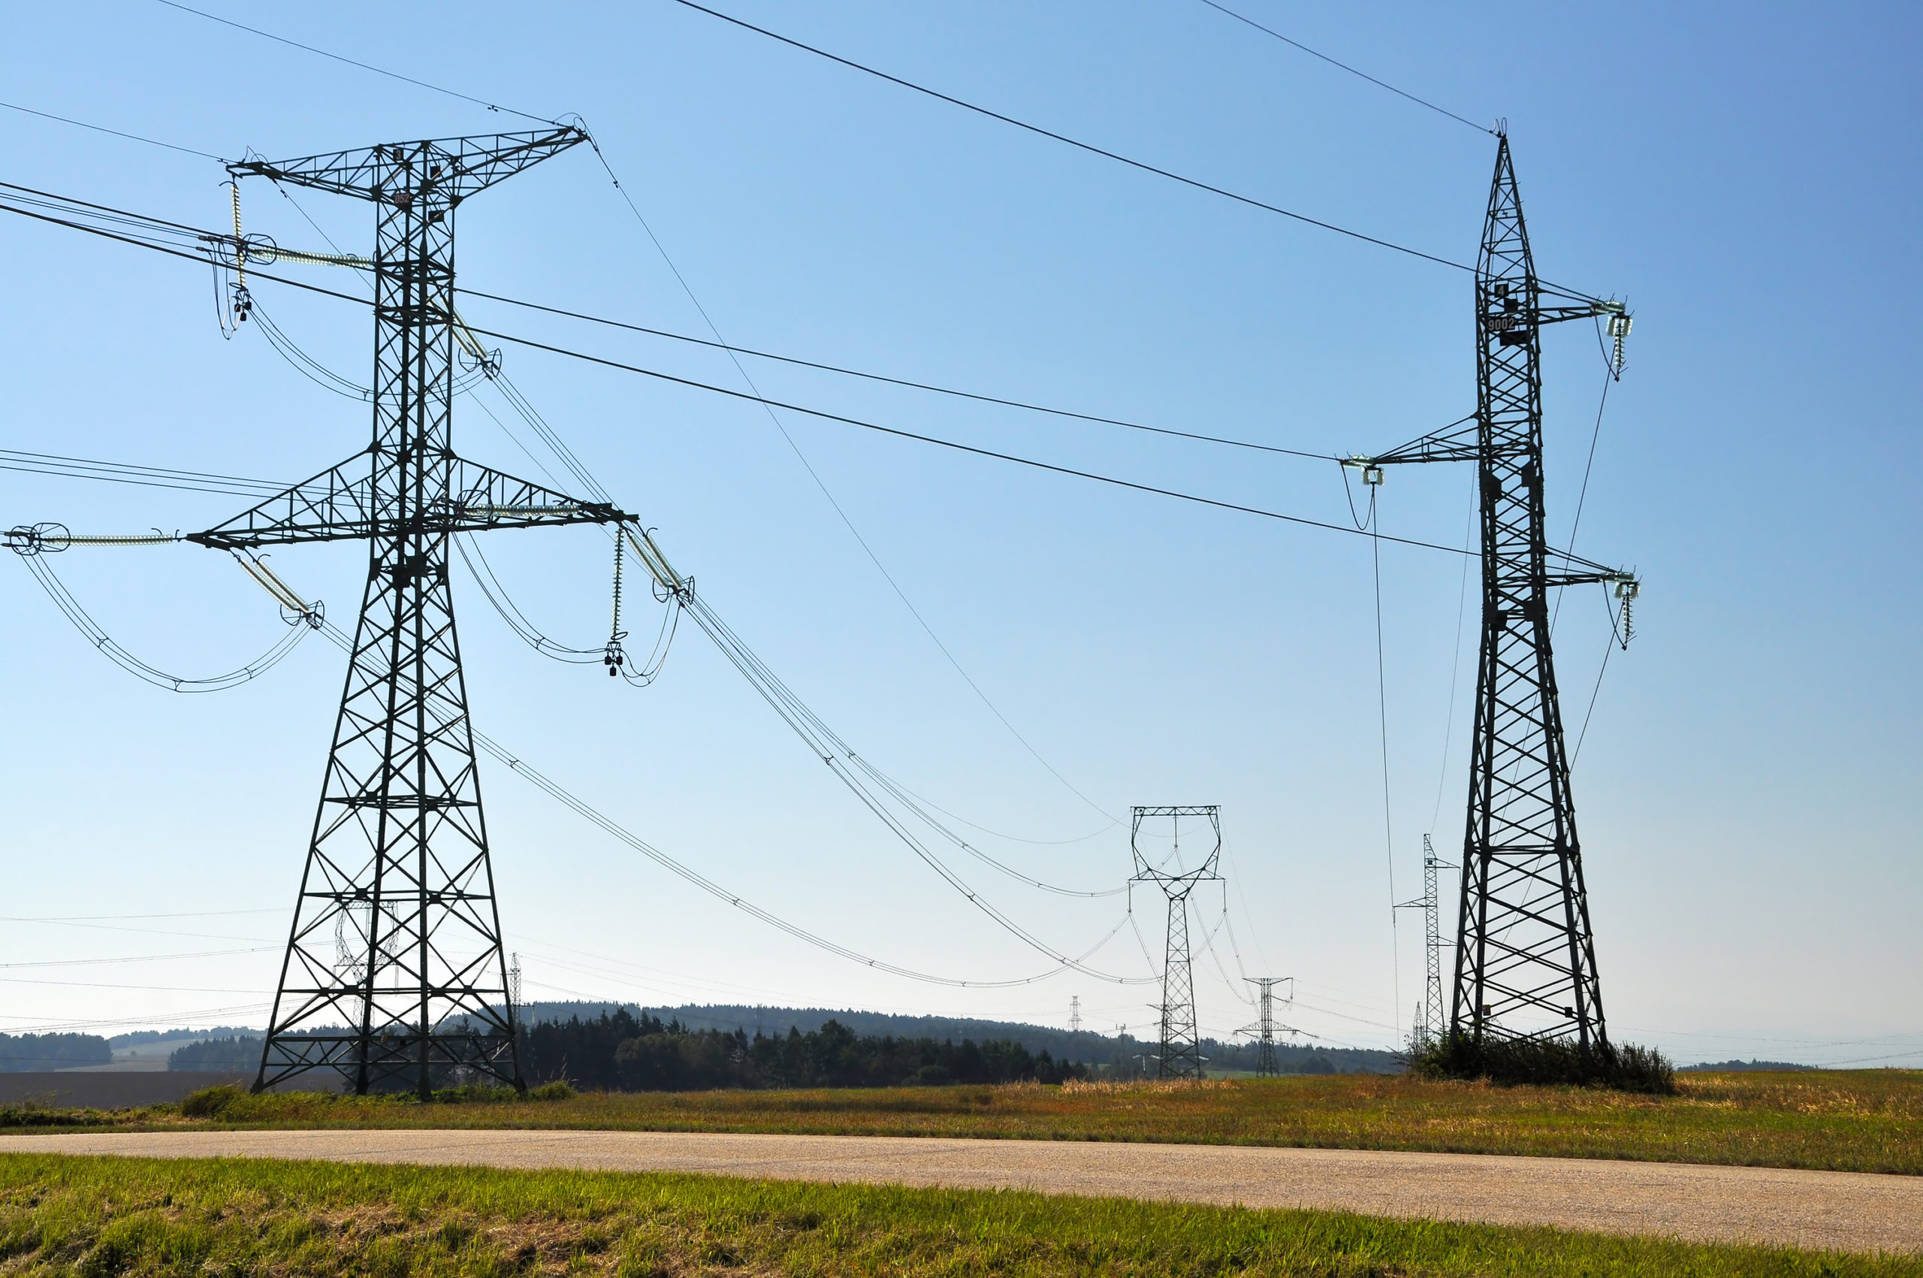
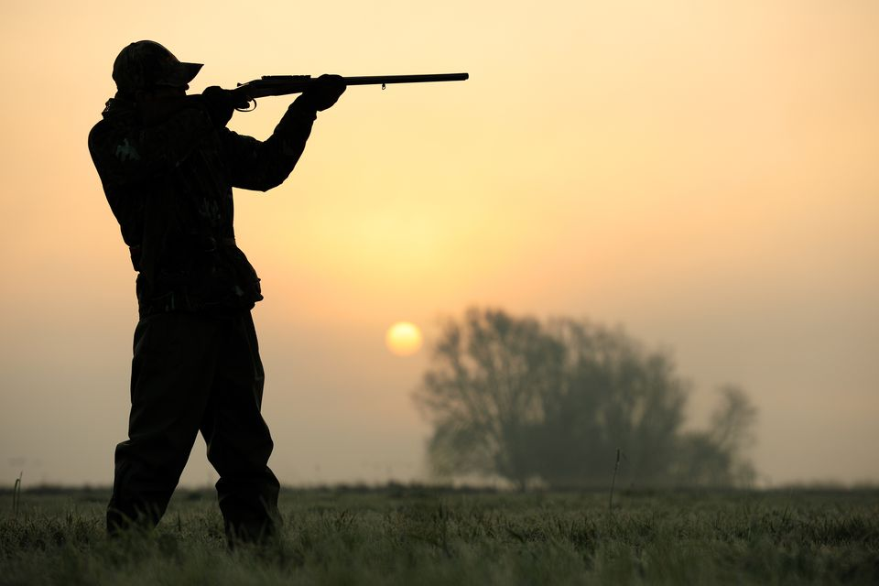
Habitat destruction
Loss of food because of pesticides and wetland destruction
Reasons why storks declined in the UK and across Europe
Hunting and persecution by people
Collision with built structures like electricity pylons

Slide 8
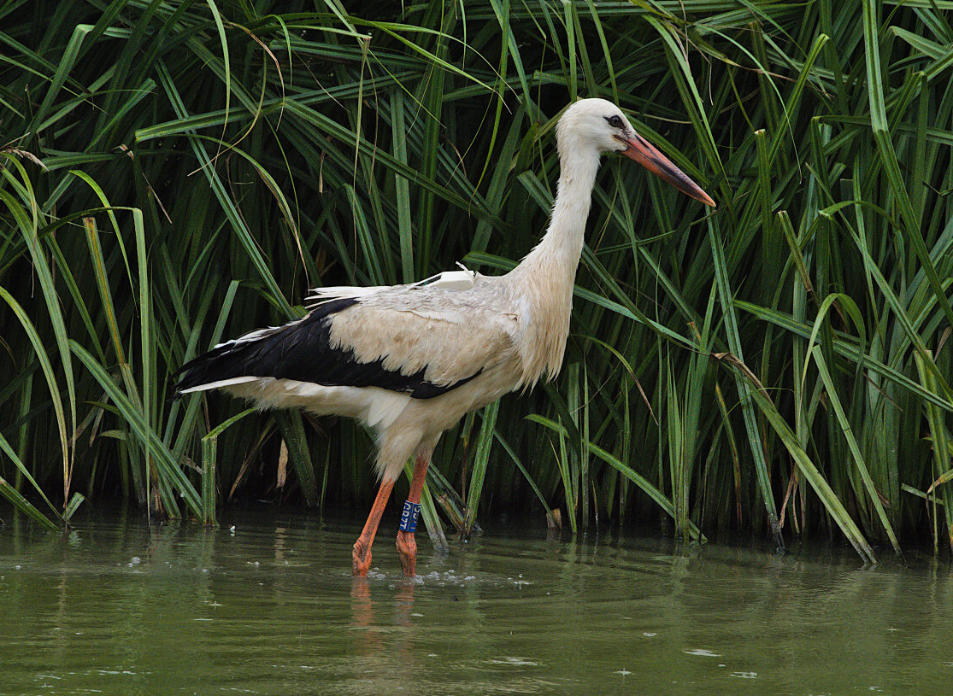
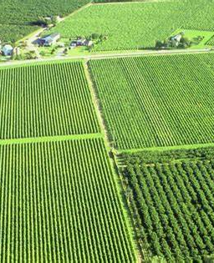
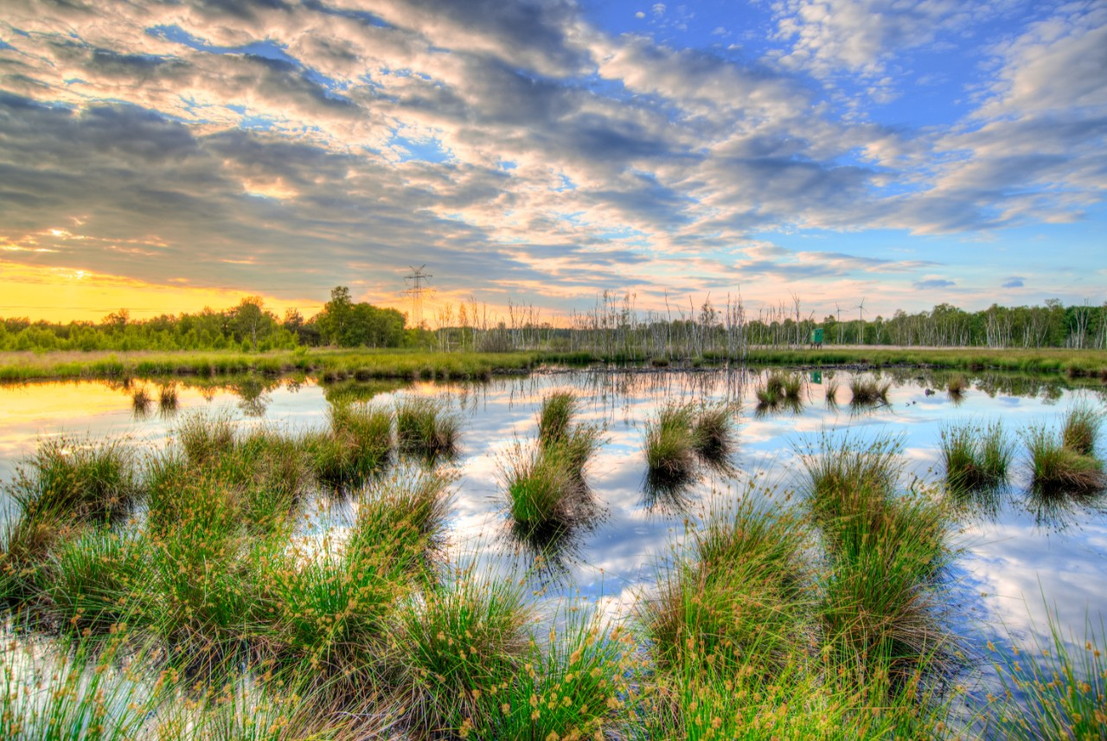
Habitat destruction
Wetlands are a fantastic habitat, vital for storing carbon as well as water.
Over the centuries they have been drained so that more land can be used for agriculture. This has had a huge impact on ecosystems and the organisms that rely on wetlands to survive, including the white stork.
Pesticides, fertilizers and fungicides that get into water systems can reduce the quality of water and effect what can live there.
Notes:
- Floodplains in the UK have been drained for agriculture since Roman times, but this has increased drastically since the Industrial Revolution

Slide 9
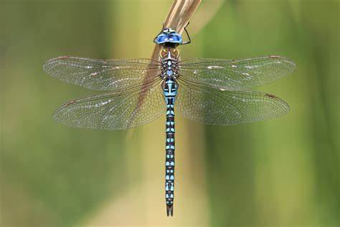
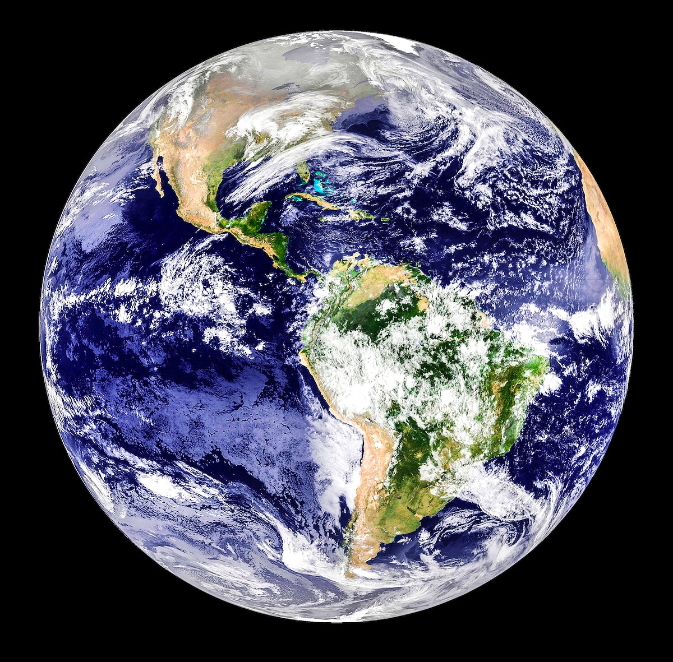
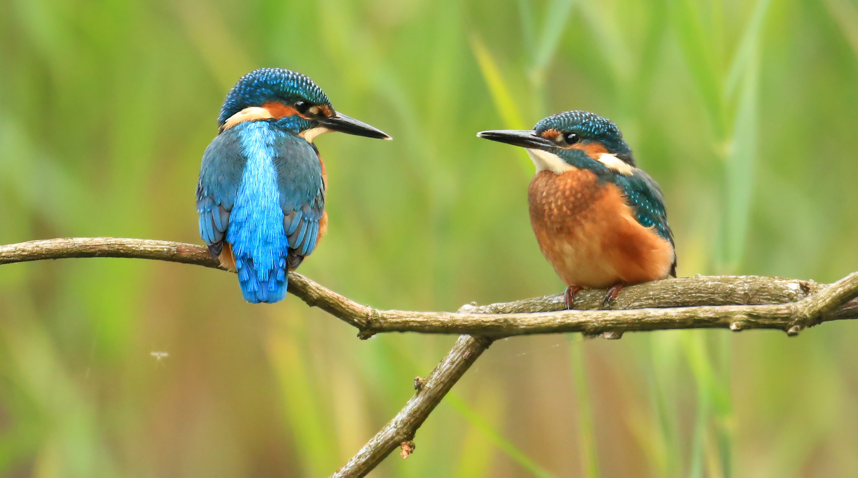
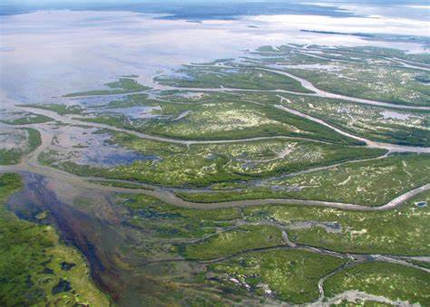
Wonderful water
What percentage of Earth’s surface do you think is covered by lakes, ponds, rivers, marshes and deltas?
1%
What percentage of habitat do you think that provides for all animal species?
10%
Notes:
This 1% of Earth’s cover includes habitat for 30% of all vertebrate species on Earth, making wetlands an incredibly valuable ecosystem.
Points to discuss could include – why wetlands have become so damaged (drainage for agriculture, pollution run off, drainage for building, sewage run off)

Slide 10
White Stork Ecology: What do you think storks eat?

Slide 11
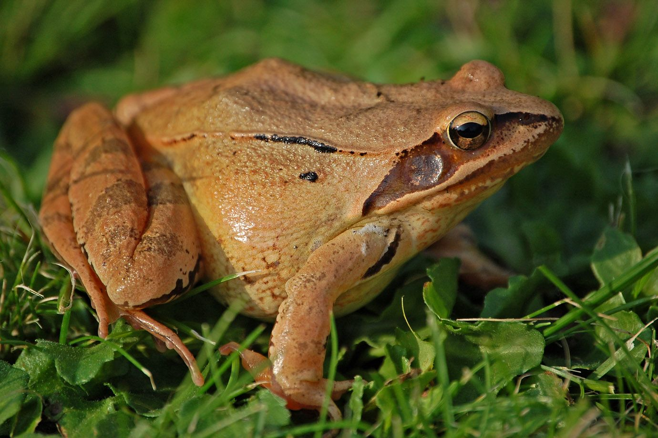
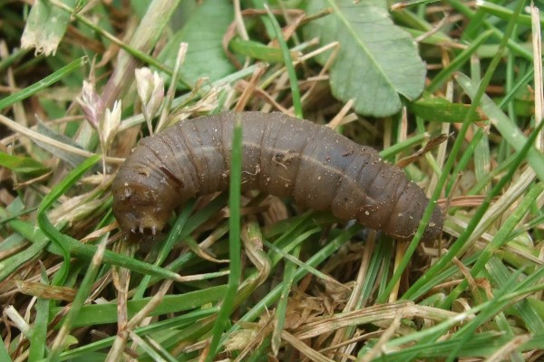
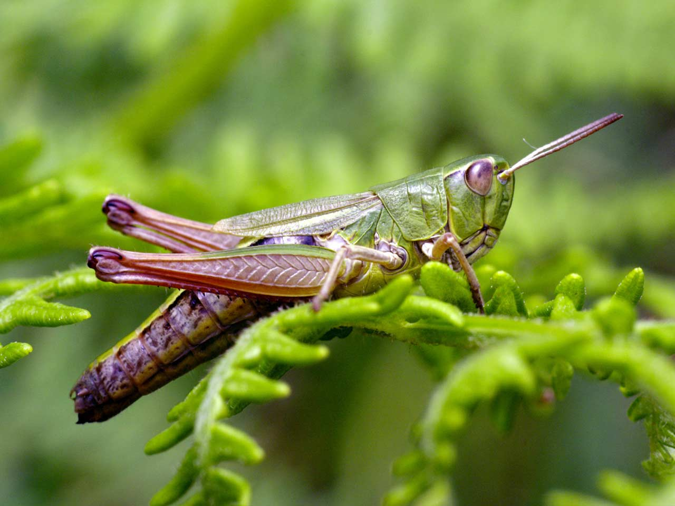
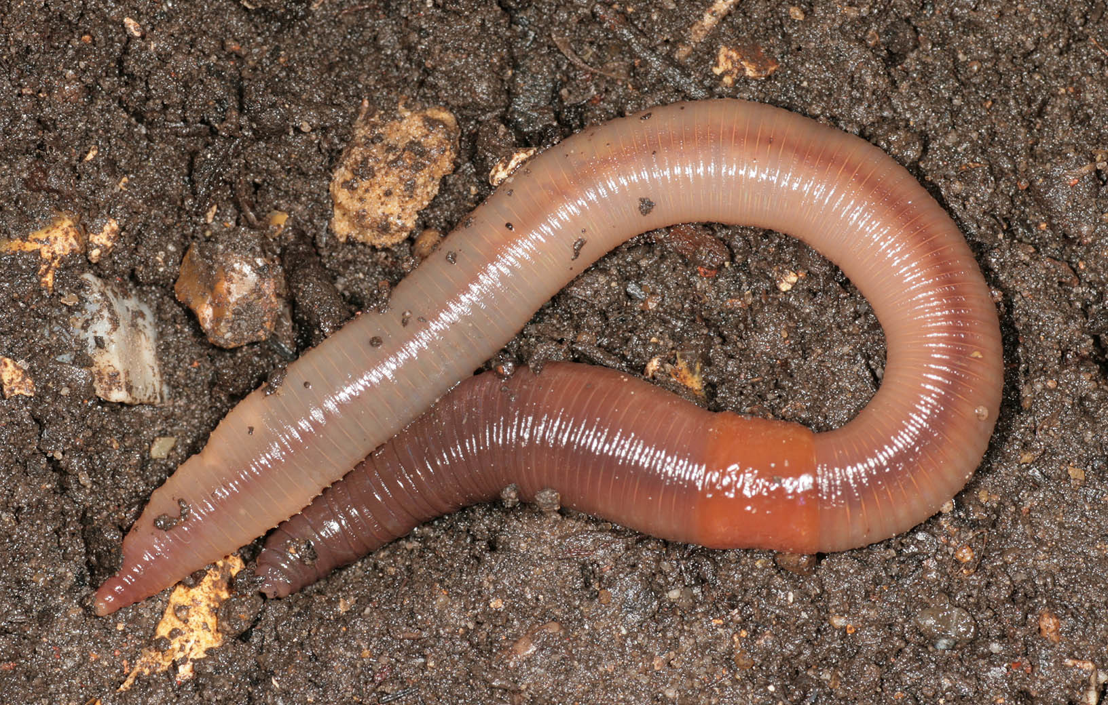
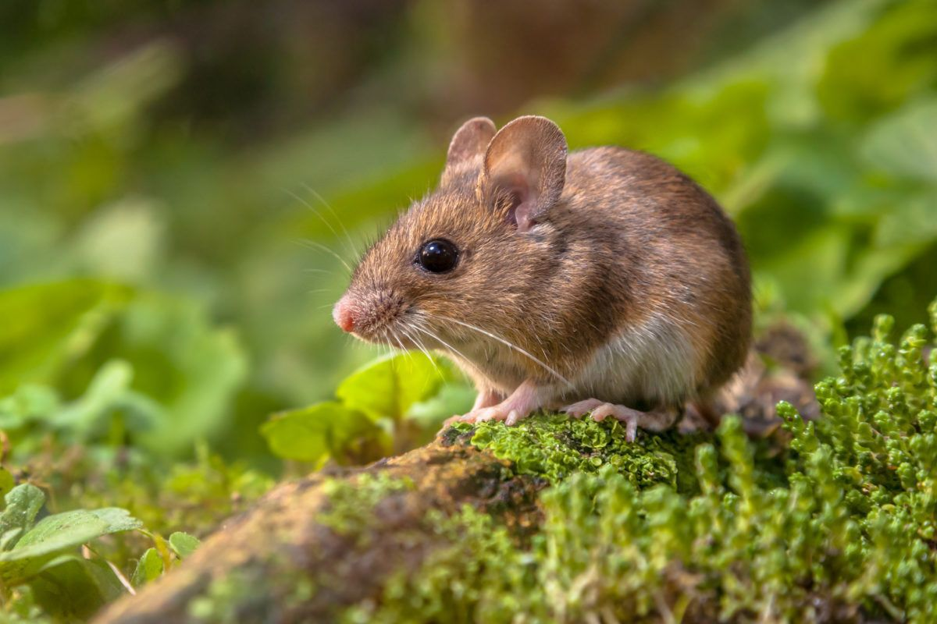
Activity: Stork Diets
Storks are not fussy eaters; they are carnivores and will eat anything that moves and will also eat carrion (dead animals) and food waste from humans. In some areas in Europe, storks have even used landfill sites as a food source.
Like owls, storks sometimes produce pellets as they digest food. This is because they often swallow their prey whole or in large pieces, including things they cannot digest like fur, exoskeletons, teeth, bones or feathers.
In the stork's digestive system, the indigestible parts from the food are compressed into a pellet while the rest of the food passed through into the intestines. The pellets are then regurgitated. Storks can produce pellets quite regularly and they are usually found on the floor near stork nests or near where storks eat.

Slide 13
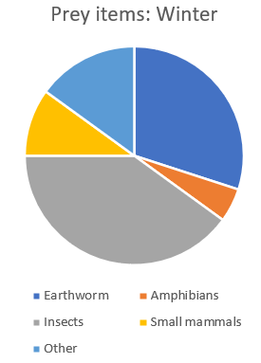
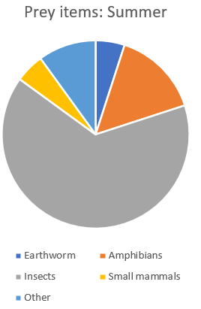
Learning about stork diets
At Knepp, we have learnt about what storks are eating through observing them but also dissecting their pellets.
Take a look at the two pie charts.
Activity:
Simply state what storks are eating throughout the year.
Compare how their diet changes in the two different seasons.
Suggest why these changes might take place.
Extension: Can you work out the approximate percentages of the different prey items? You can then use these to give more detail to the comparison on seasonal diet changes.

Slide 14
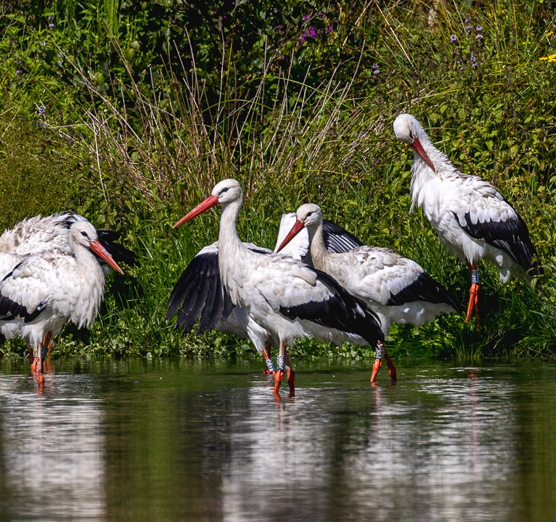
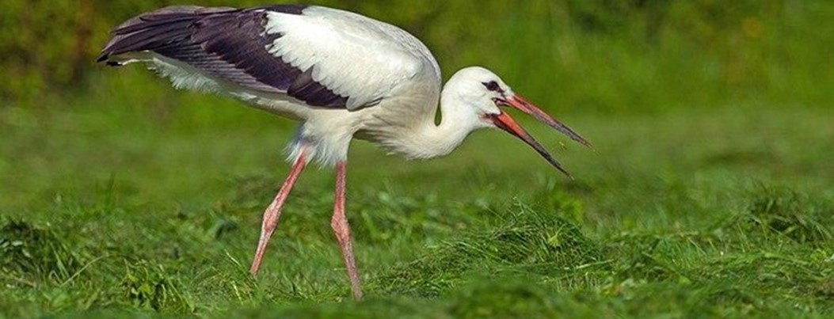
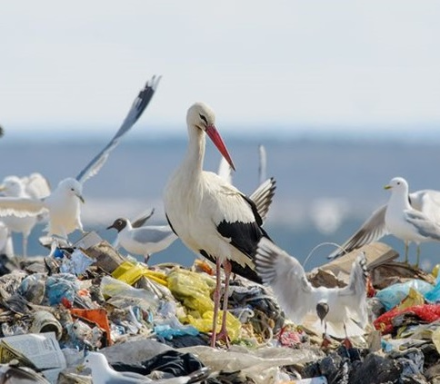
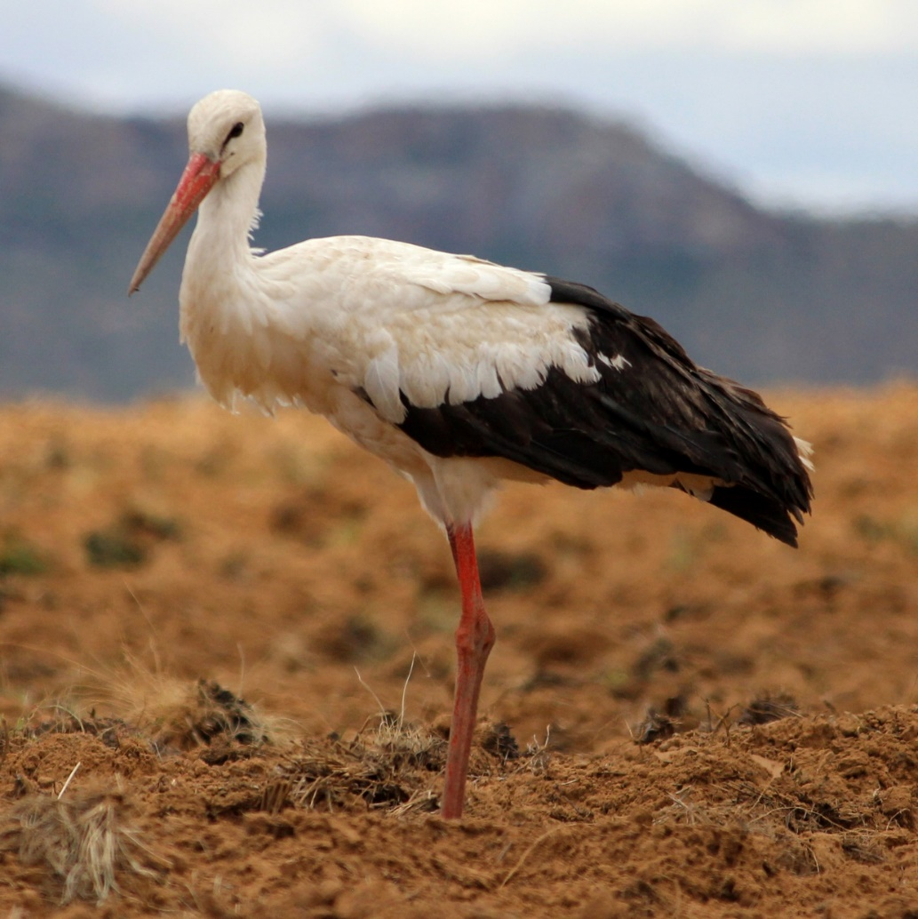
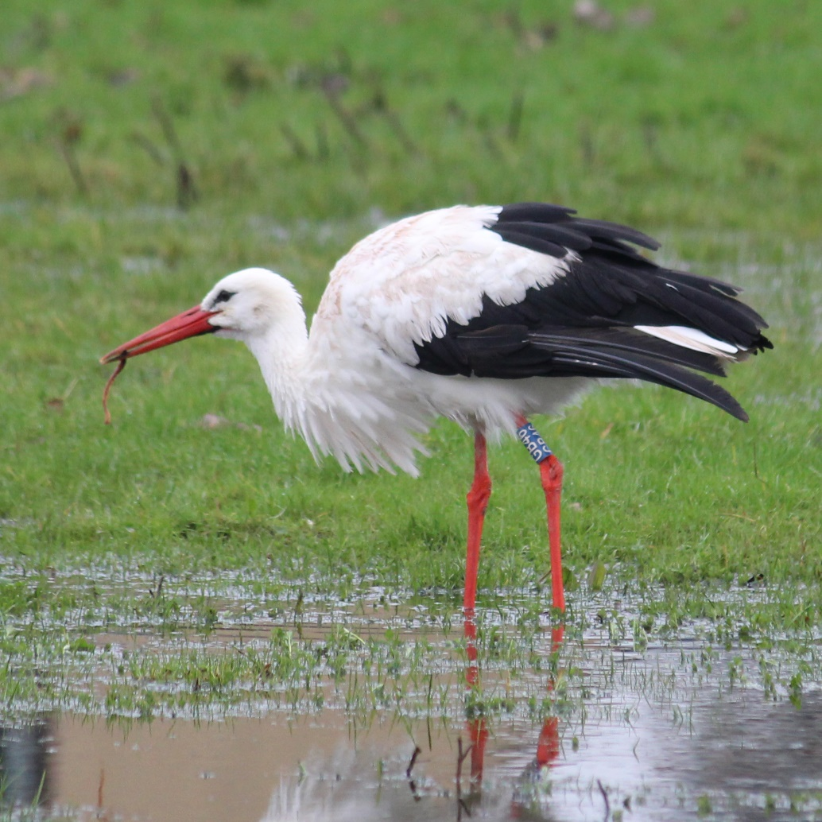
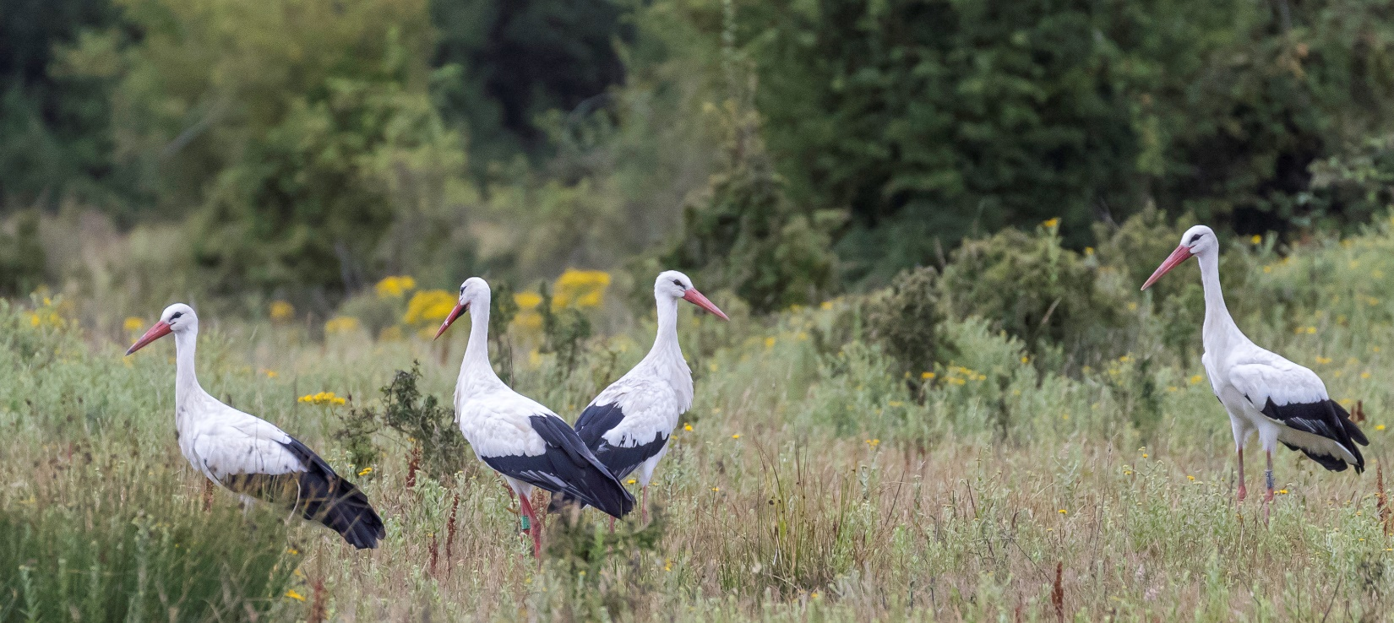
Notes:
Prefer areas of open wetland, particularly grassy areas which are wet or periodically flooded: riverbanks, marshes, floodplains and meadows
Avoiding areas with greater woodland cover
Savannahs, dry grasslands across their migratory route
Over recent years landfill sites and surrounding habitats are important
Large proportion of diet is made up from insects, beetles, crickets
30% can consist of worms
Will follow locust swarms on migration and in over wintering sites
Will eat a wide variety of other species too including fish, amphibians, reptiles, and small mammals
When they are nesting, they will usually forage within a 5km radius of the nest
Highly adaptable and are using landfill sites across Europe as food sources, some populations have ceased migrations and live on these sites all year round, rearing young at those sites.

Slide 15
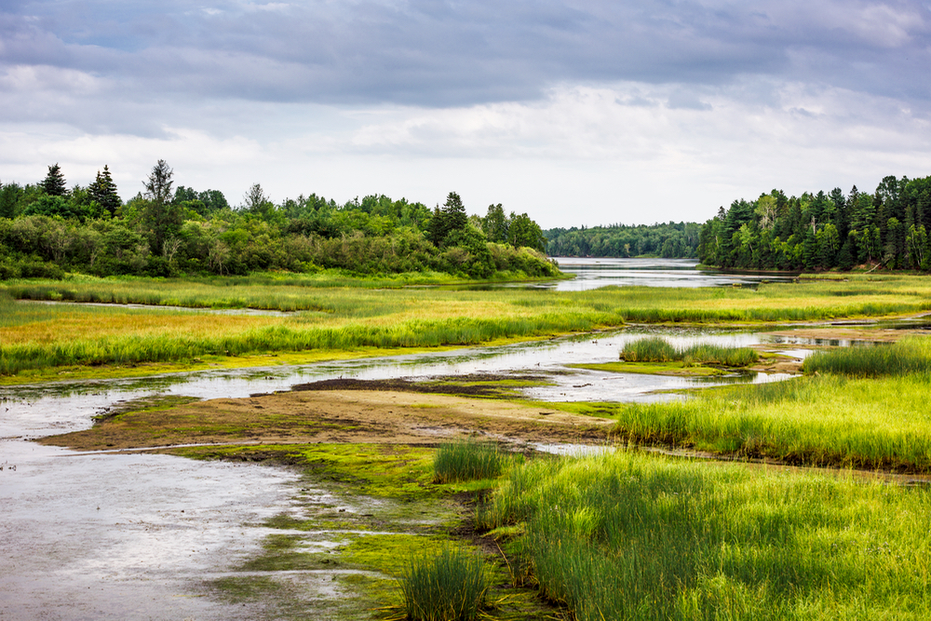
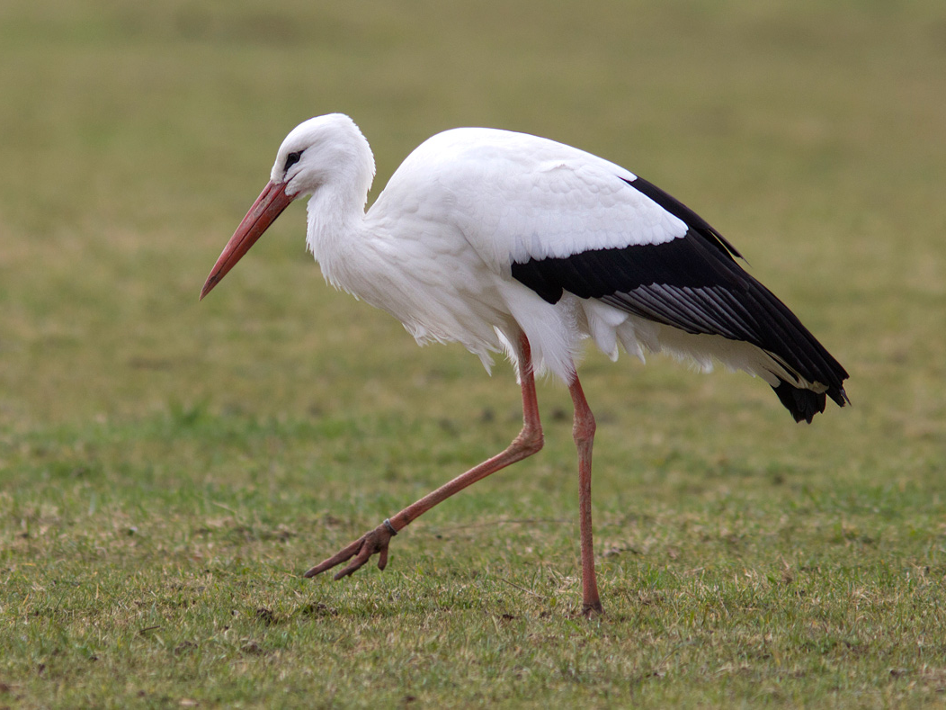
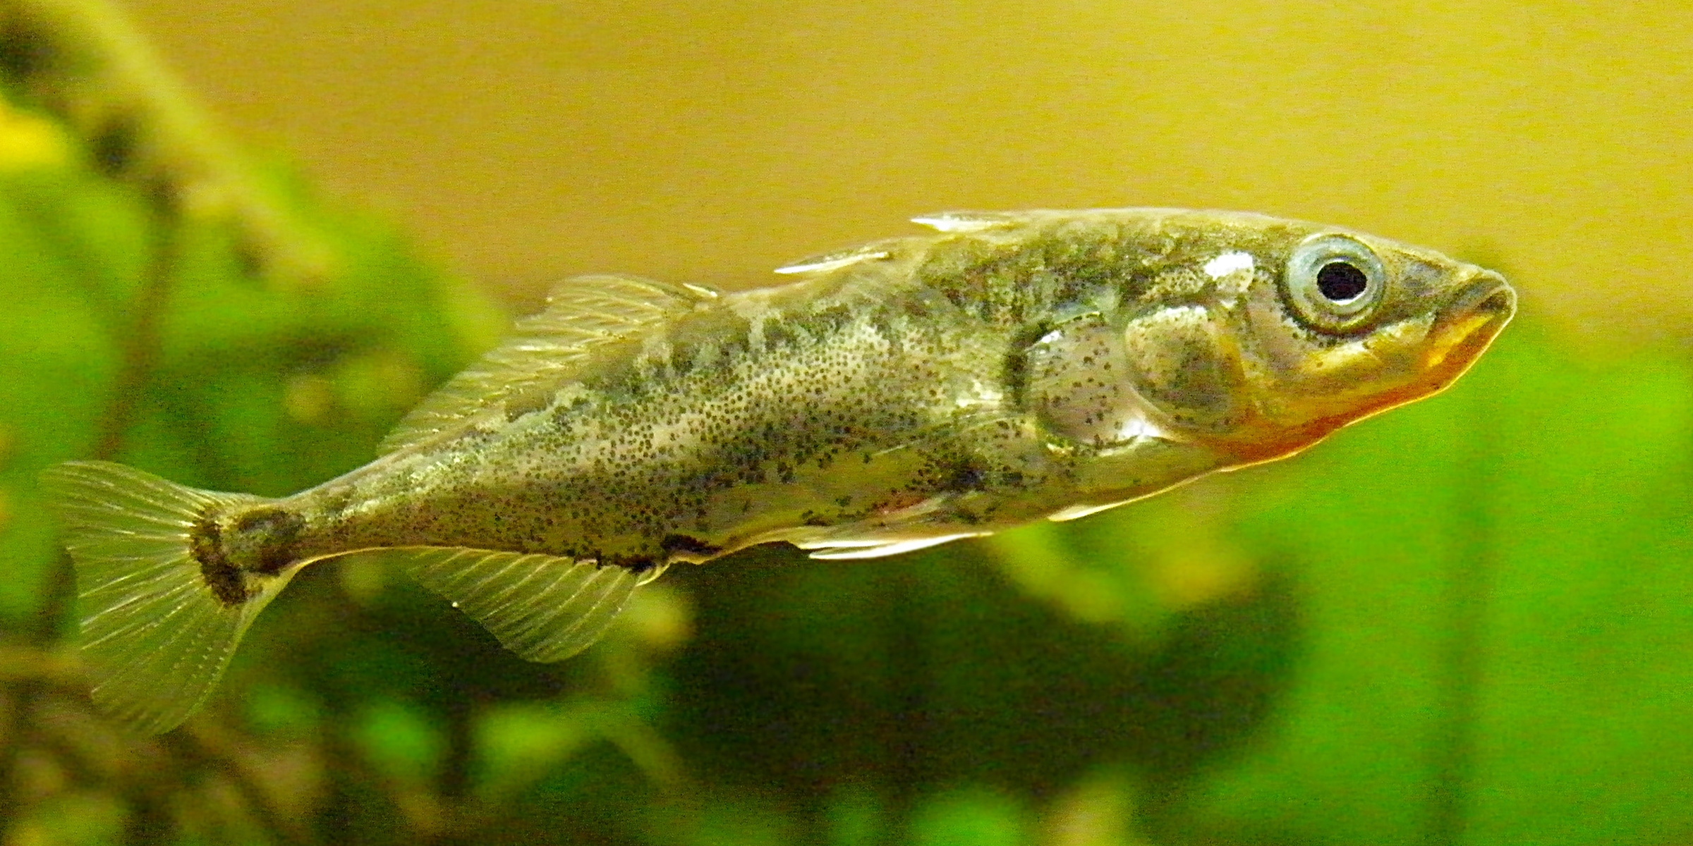
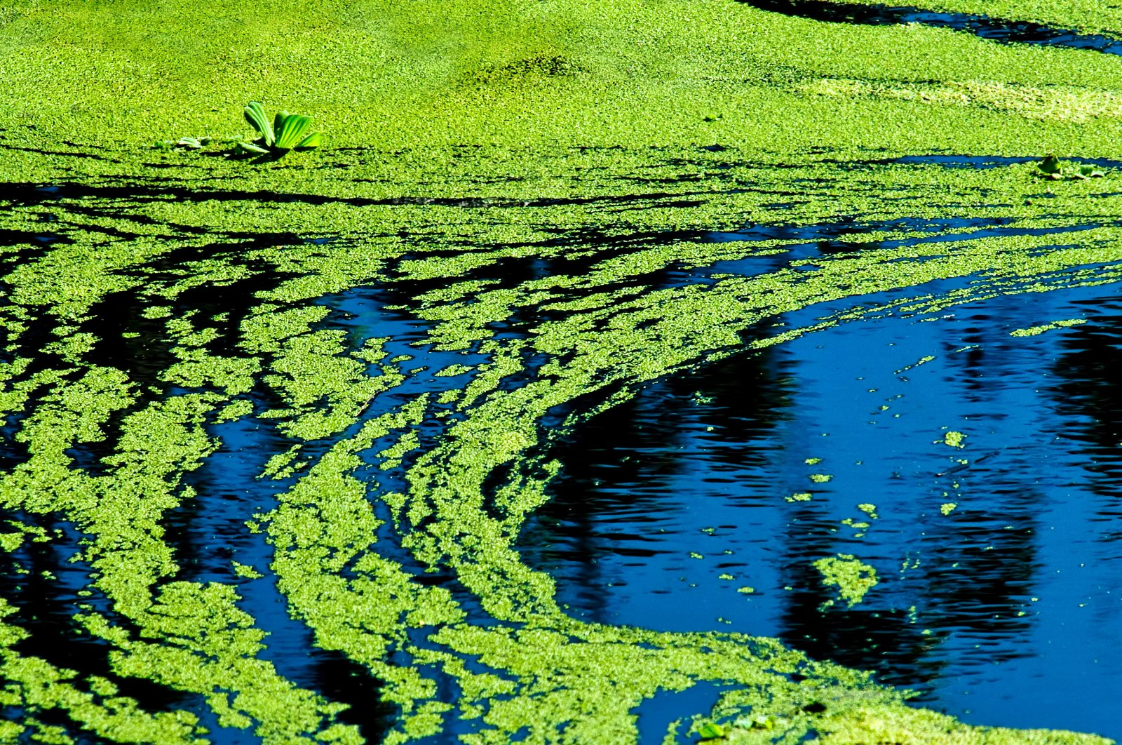
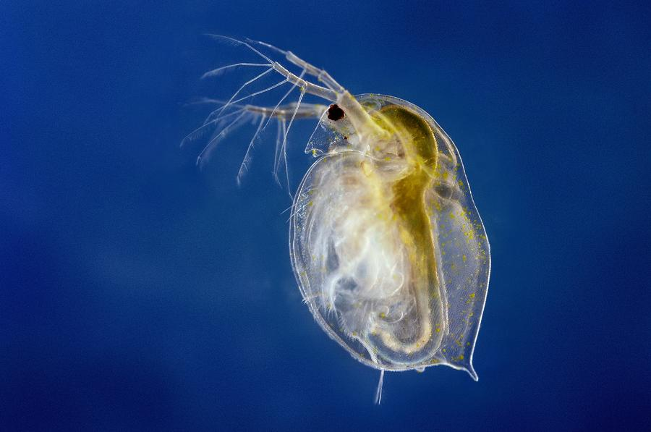
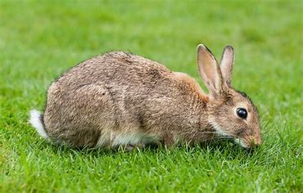
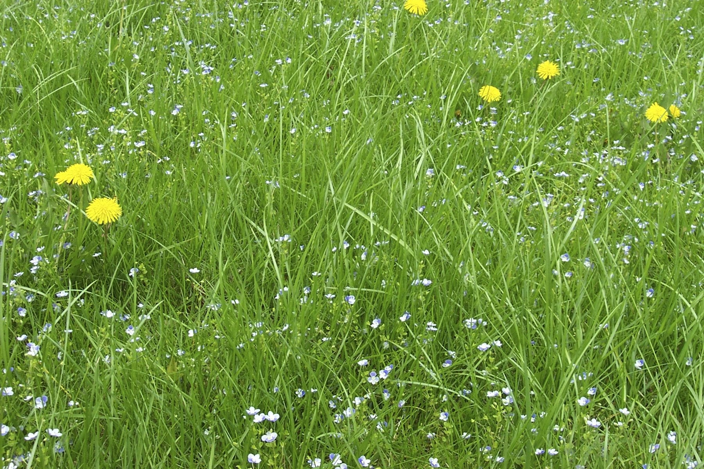
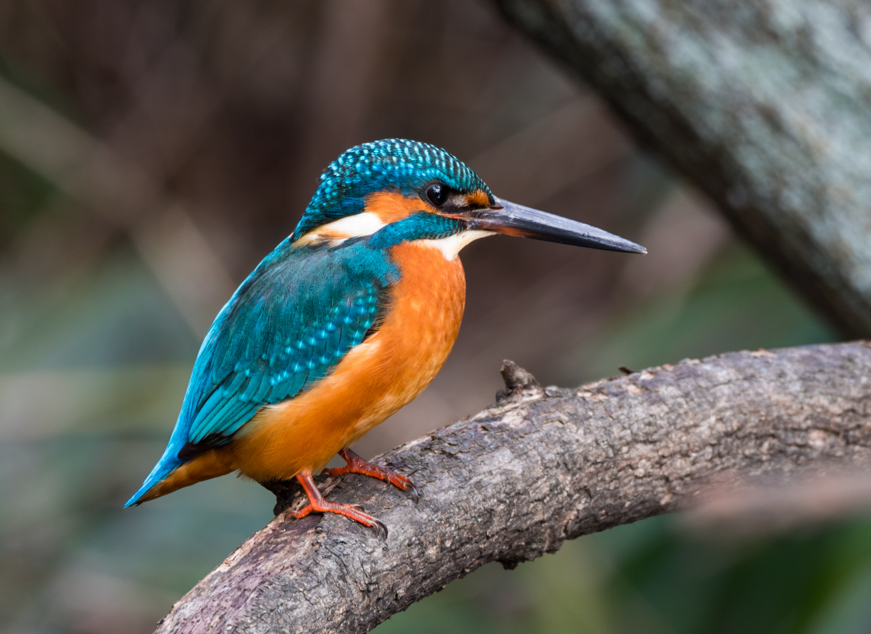
How many of these native organisms can you name? What do you know about them?

Slide 16
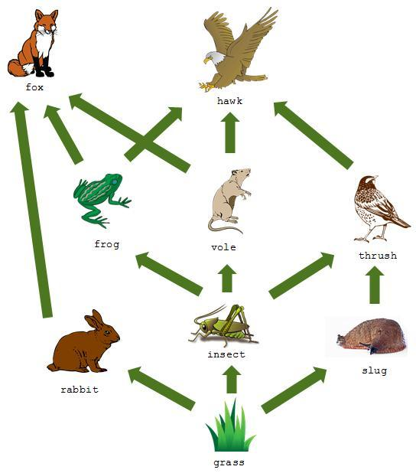
Food webs and food chains
Food webs and food chains are diagrams that show the feeding relationships and movement of energy in an ecosystem.
The arrows show the direction of movement of energy.
In healthy ecosystems, energy and nutrients are constantly recycled by different processes such as photosynthesis, digestion, excretion and decomposition.
Every organism has its own role to play in this.

Slide 17
Connect as many organisms as you can to show their feeding relationships as part of a food web.
List as many examples of food chains within the food web as you can.
Suggest what you think would happen if the population of worms declined in this ecosystem.
White stork
Kingfisher
Stickleback
Mouse
Frog
Grasshopper
Dung beetle
Daphnia
(water flea)
Rabbit
Worm
Grass
Algae

Slide 19
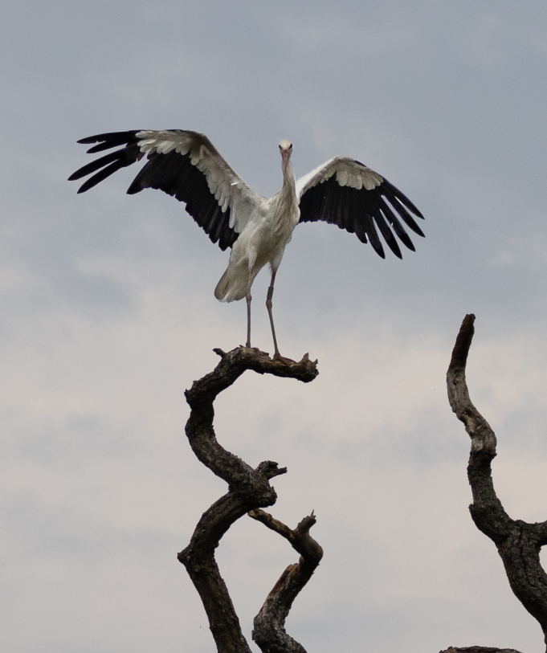
True or false?
1. Storks are native to the UK.
TRUE – They were last breeding here around 600 years ago
2. In a food web, the direction of the arrow points to the place where energy has come from.
FALSE – It points to the place energy goes.
3. A habitat is the place where an organism lives.
TRUE – It is made up of the abiotic (non living) and biotic (living) factors
4. 10% of the Earth’s surface is covered by lakes, ponds and rivers.
FALSE – It is 1%, but these freshwater areas provide habitat for 10% animal species
5. Pesticides and fertilizers are an important tool in managing ecosystems.
FALSE - These are chemicals used in intensive agriculture

